Slide 1
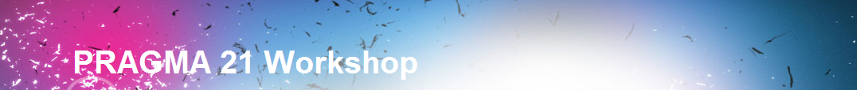
Progress Since PRAGMA 20 PRAGMA Future Possibilities
Sapporo, Japan
18 – 19 October 2011
In conjunction with GEOGrid
Organizer: AIST
Co-Organizers: Osaka University, Tokyo Institute of Technology, University of Tsukuba
Notes:
http://pragma21.pragma-grid.net/dct/page/65580

Slide 2

Thank you for including PRAGMA

Slide 3

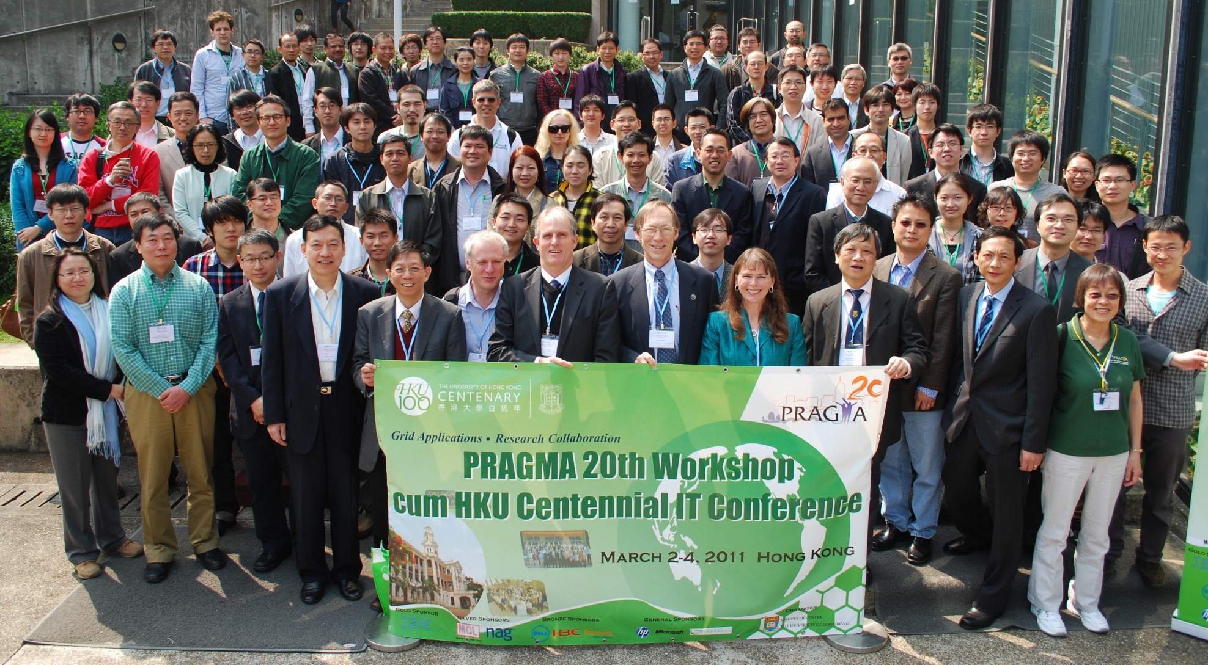
PRAGMA 20

Slide 4
Unwavering Determination, Humility, and Commitment

Slide 5

Highlights
VM Migration Experiment
Disaster Recovery of key services
Technology to engage public in cultural heritage
PRIME in 8th year - producing results
MURPA in 4th year – expanding institutions
Stimulating other advances in members and partners

Slide 6
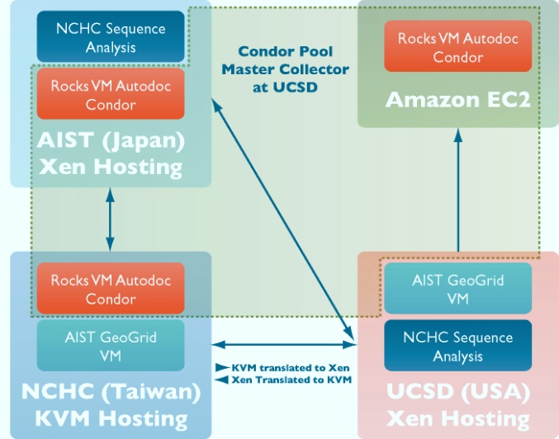
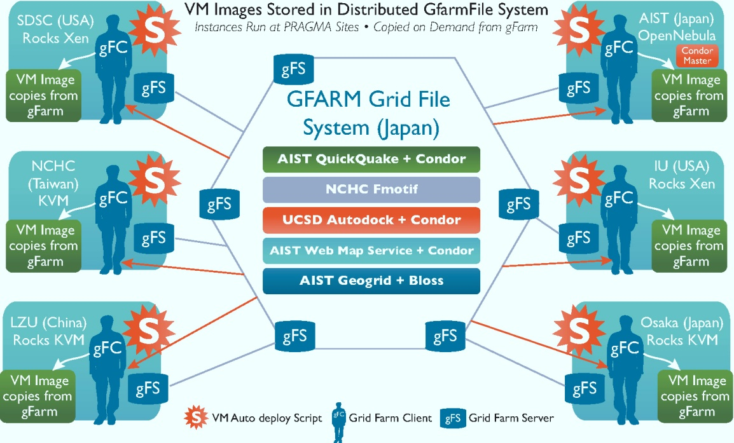
VM Migration Experiment – Phase 2 From Grids to Clouds
A key demonstration
Building on progress since PRAGMA 20 (building from panel discussion at PRAGMA 17 in Hanoi)
The key is automation!
Use of PRAGMA member technologies (Gfarm)
Future challenges
Data and computing
Interoperability
Core Participants:
AIST, NCHC, SDSC/UCSD
Additional Participants
IU, Osaka, LZU, UH
Phase 1: PRAGMA 20
Phase 2: PRAGMA 21
Notes:
Experiment 1:
Two different hosting environments
Three different application VMs: two authored in Rocks Xen, one in KVM
Manually migrated vms
Experiment 2:
- Automating VM migration process
- Authoring VMs (AIST – applications relevant to earthquake disasters)
- Build Gfarm system

Slide 7
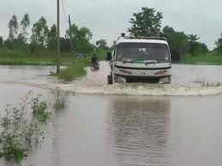
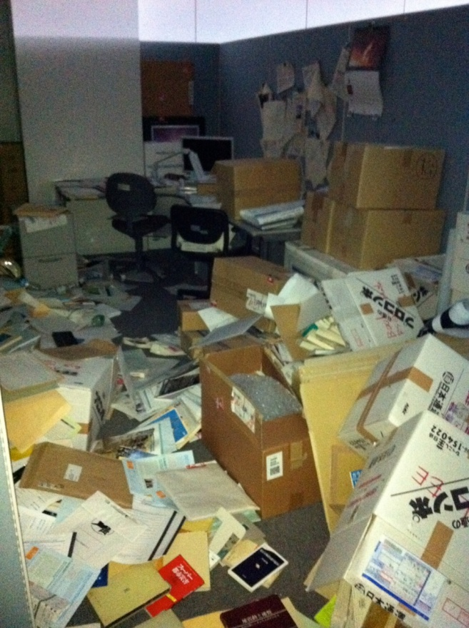
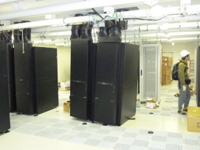
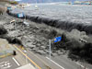
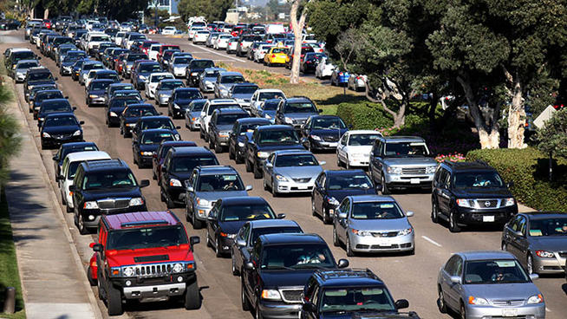
Disaster Recovery of Key Services
Massive earthquake and resulting tidal wave was devastating for Japan, AIST systems out of service
NCHC,SDSC/UCSD, other institutions in Japan, and U Chicago (R Grossman) assistant, migrate services
Key talk by Masashi Matsuoka!
Can PRAGMA members provide infrastructure to other members for this type of
persistence of key services at a
time of disruptions?
Notes:
NCHC: Naruto cluster, consisting of 16+1 nodes,
SDSC/UCSD: part of Triton resource

Slide 8
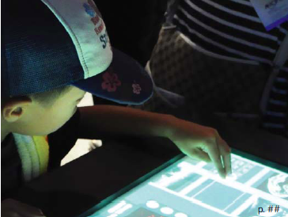
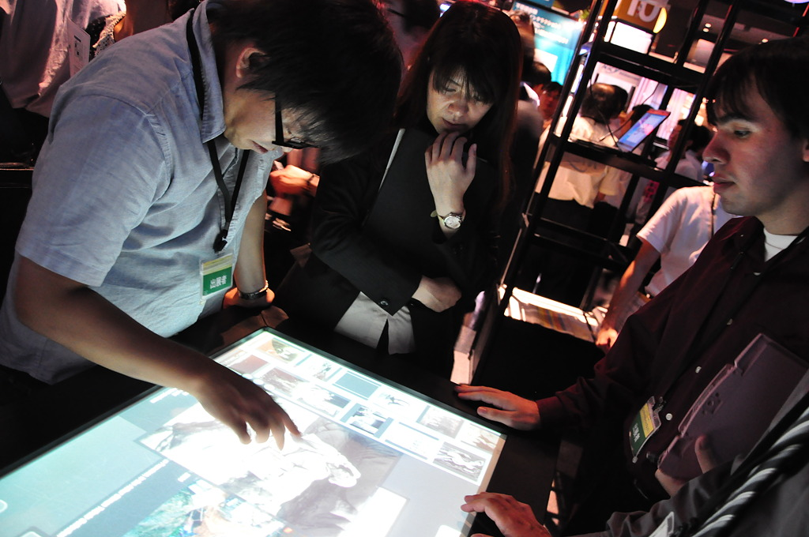
Sharing and Preserving Cultural Heritage My Gallery Interactive
Multi-touch screen, allowing users to create their own gallery
Content from Museum of Photographic Arts San Diego (MoPA)
Built on technology developed by PRIME undergraduate in 2010
Built by PRIME undergraduates in 2011, in collaborations with mentors
Shown in Knowledge Capital 2011 technology exhibition held in Osaka, Japan
Plans to deploy at MoPA in fall 2012
Demo and poster
Participants: NICT, UCSD, MoPA

Slide 9
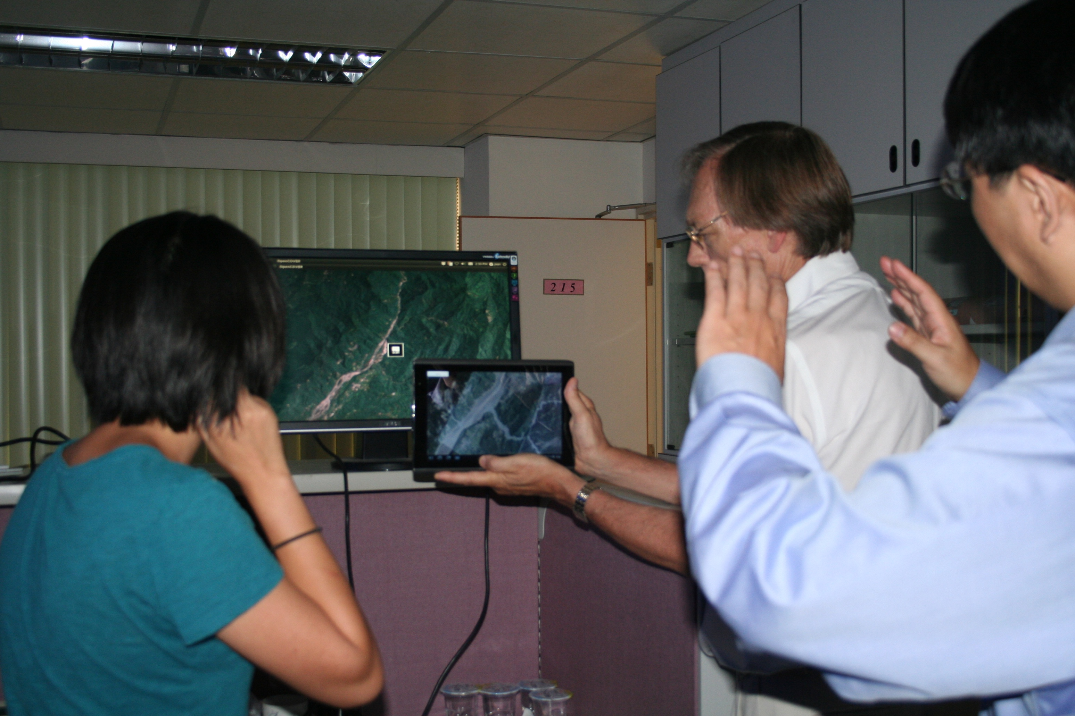
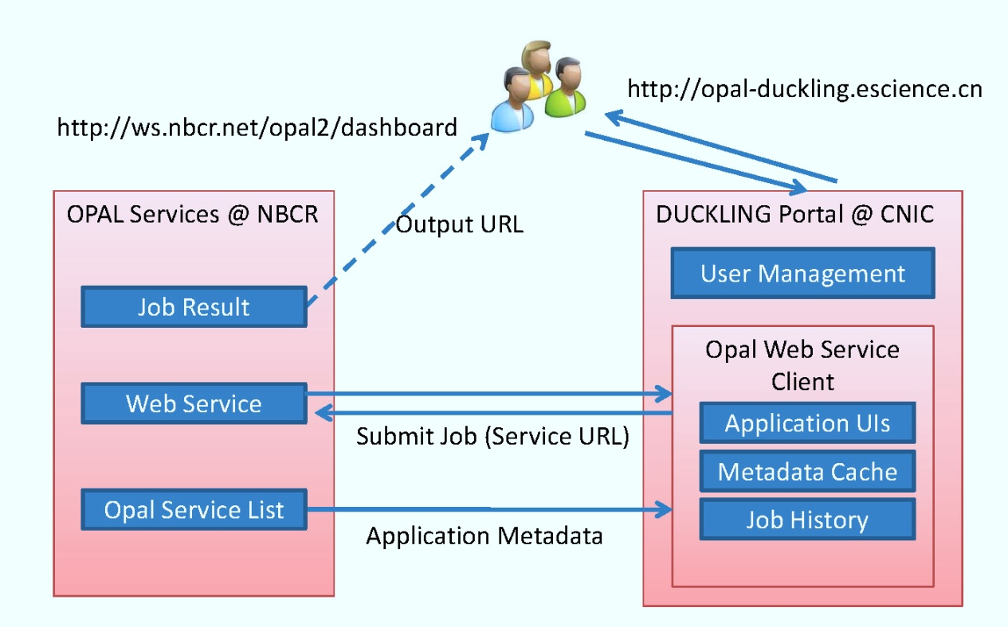
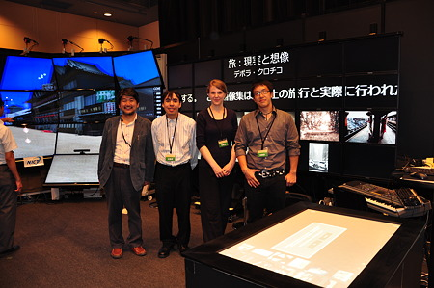
PRIME – Developing Technologies
Integration of the Opal Web Service Client into the Duckling Portal
Resulted from
PRAGMA 20
discussion
CNIC
Demo
Augmented Reality in Android System with a Disaster Response Application
Prototype of use of “every day” devices to integrate realtime data onto previous reality
NCHC
Navi: Covise-Kinert Navigation Interface with Cultural Heritage Application
NICT, Osaka
Notes:
Kinect is a motion capture device sold by Microsoft with their game engine; COVISE—COllaborative Visualization and Simulation Environment—is an extendable distributed software environment to integrate simulations, postprocessing and visualization functionalities.
created a navigation plug-in to interface a Kinect device with COVISE to enable users to explore a Virtual Reality Modeling Language (VRML) model through movements and gestures.

Slide 10
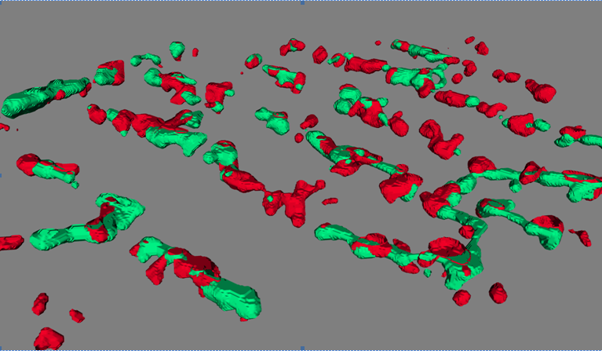
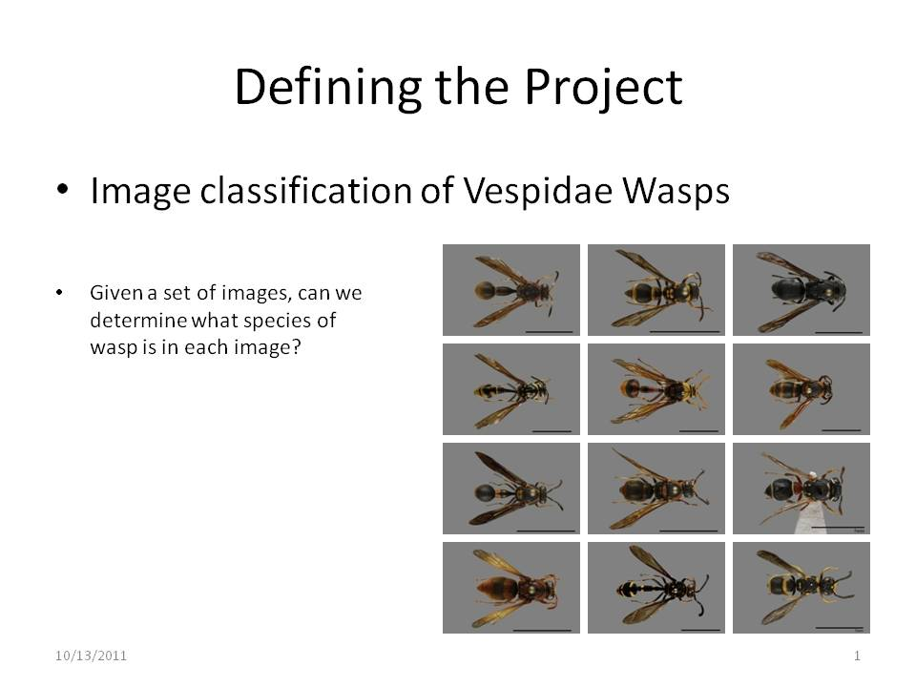
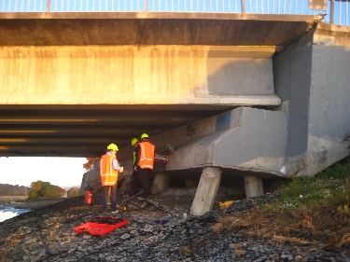
PRIME – Imaging and Databases
Imaging in heart muscle
Auckland
Automatic image classification in wasps
TFRI
Database development on damage in NZ
Auckland
Notes:
Looked at the structure and patho-physiological function of this muscle regulatory unit (malfunction of this unit leads to heart failure
Joseph Wong’s work in Auckland: Volume-rendered 3D dSTORM super-resolution microscopic image. RyR (ryanodine receptor) clusters (red) are distributed along T-tubules (green). Herein, caveolin-3 immuno-staining is used to determine T-tubule structure. Estimated resolution of this image is ~30 nm, which is approximately 10 times better than that of conventional light microscopy.
The geometry of clusters was remarkably heterogeneous – unexpected
Adrian: Adrian developed an analysis workflow for transforming raw images into quantitative features and then conducted experiments with various feature selection and machine learning algorithms. His experiments produced high classification accuracy on the target problem and confirmed the feasibility of this approach.
Sean and Chris: developed a detailed database to collect damage and performance data on a small group of bridges affected by the recent earthquakes. Their responsibilities included documenting information on the foundation of each structure, calculating the mass of bridge components, traveling into the field to collect concrete samples and measurements, and categorizing evidence of damage progression. The compiled work was reviewed by researchers who will use the information to determine which bridges will be selected for detailed inspections.

Slide 11
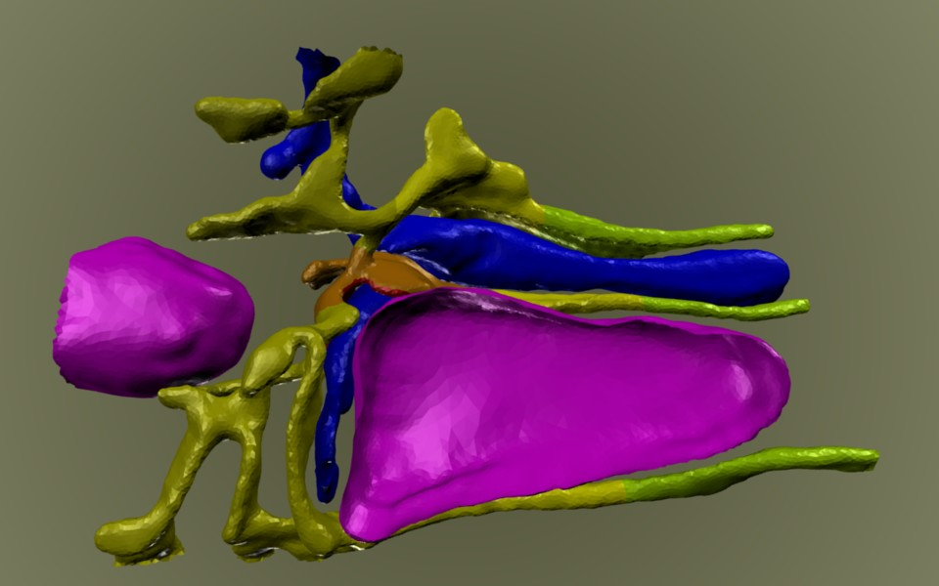
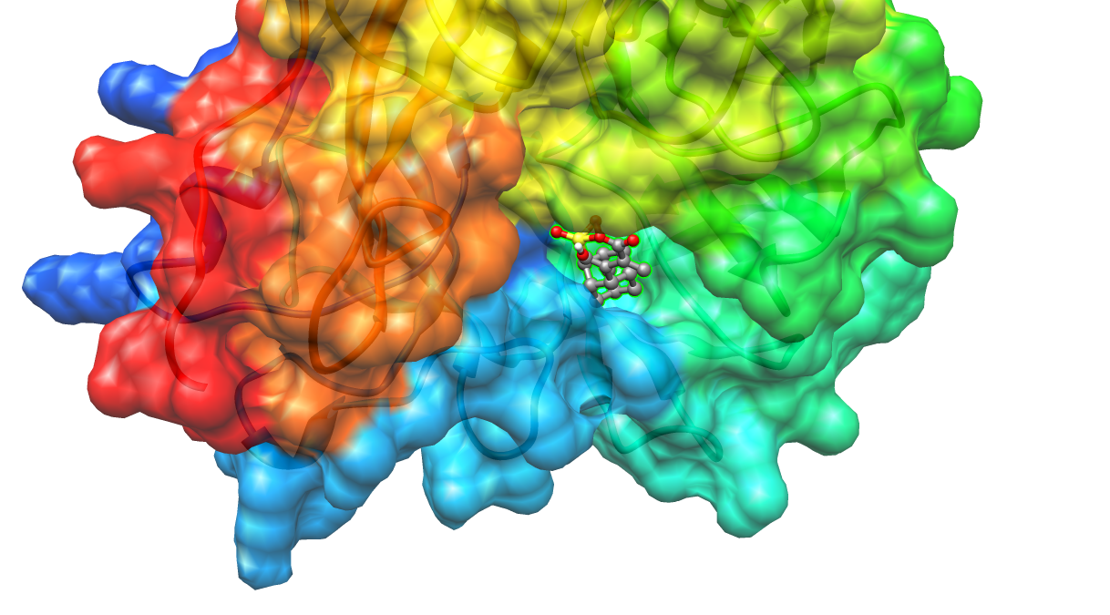
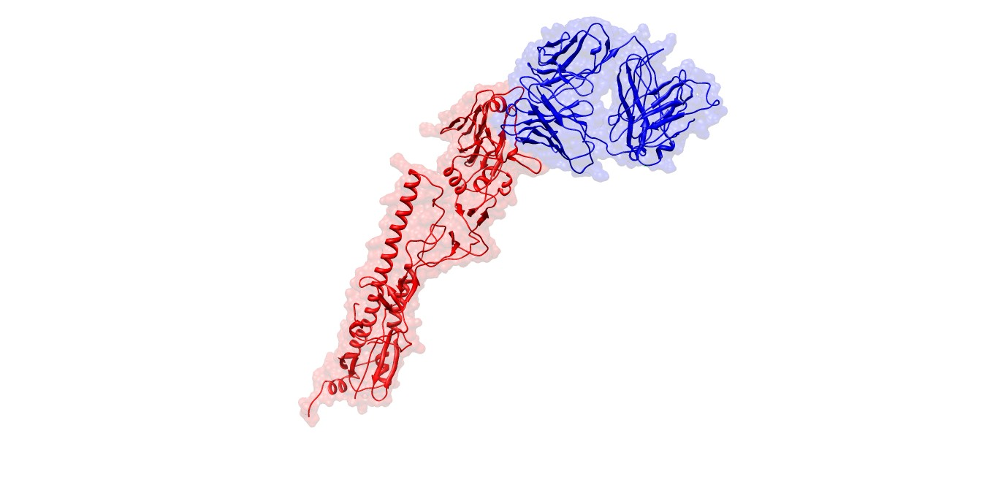
PRIME – Bioscience Modeling
Modeling in cardiac myocytes
Monash University
Virtual screening, protein model building, influenza virus research
Osaka; CNIC, USM, NTU
Notes:
Jerry Tsai: understand what regulates the size and duration of a single calcium spark in the cell (sarcoplasmic reticulum) … - by using nimrod to run some experiments – got some interesting results regarding location of pump and duration of spark
Howard Li: novel finding that adamantine, a known influenza inhibitor rendered obsolete due to viral resistance, may contain a scaffold effective for synthesis of new inhibitors against drug resistant forms of neuraminidase.
Alex
Docked pose produced by RDOCK of HA(red) and S139/1(blue). The predicted FEB is -15.0288 kcal/mol based on preliminary docking results.
Interested in looking at antibodies that bind to HA (hemagglutinin)
Daniel Li, Brian Tsui and
Visualization of (A) actual and (B) modeled three-dimensional structure of SSH-2 (2nt2) from the improved workflow. (C) is the overlay of the actual and modeled structures. Note the very close agreement of the two structures. The colors have been changed (grey=actual, orange=modeled) for clarity.

Slide 12
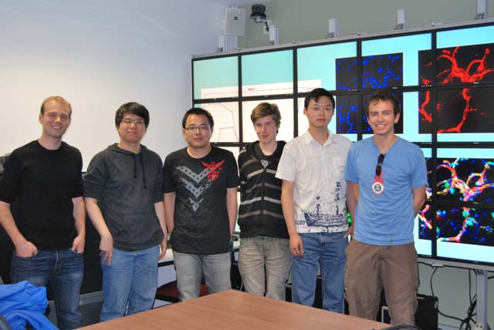
MURPA
Expanded Program in 2011 to NCSA
Will expand again in 2012 to Technion
Student | Location | Mentor | Title
Geoff Pascoe | UCSD | Sameer Tilak | Cross Network Platform for Environmental Sensor Data Capture and Analysis
Lin Wei | UCSD | Wilfred Li | Integrating Web Services, Nimrod and Kepler in Biomedical Workflows
James Wetter | UCSD | Jurgen Schulze | Real Time Visualisation in Astrophysics
Wai Keung Yiu Man Lung | UCSD | Ilkay Altintas | Binding ITK with Kepler for Medical Workflow Imaging
Edgar Kautzner | NCSA | Ben Smith | Telematics in Music Collaboration, Rehearsal and Performance
Jian Zhang | NCSA | William Gropp | Integration of Guard Parallel Software Debugger into Blue Waters HPC Environment
Notes:
2010 Geoff Pascoe Cross Network Platform for Environmental Sensor Data Capture and Analysis UCSD Dr Sameer Tilak Slides/Video 2010 Lin Wei Integrating Web Services, Nimrod and Kepler in Biomedical Workflows UCSD Dr Wilfred Li Slides/Video 2010 James Wetter Real Time Visualisation in Astrophysics UCSD Dr Jurgen Schulze Slides/Video 2010 Wai Keung Yiu Man Lung Binding ITK with Kepler for Medical Workflow Imaging SDSC Dr Ilkay Altintas Slides/Video 2010 Edgar Kautzner Telematics in Music Collaboration, Rehearsal and Performance NCSA Ben Smith Slides/Video 2010 Jian Zhang Integration of Guard Parallel Software Debugger into Blue Waters HPC Environment NCSA Prof William Gropp

Slide 13
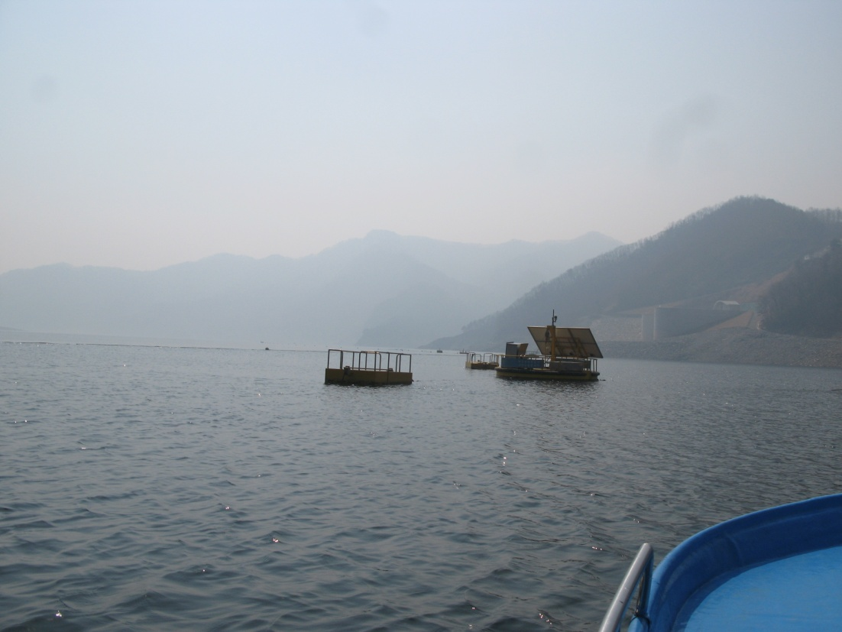
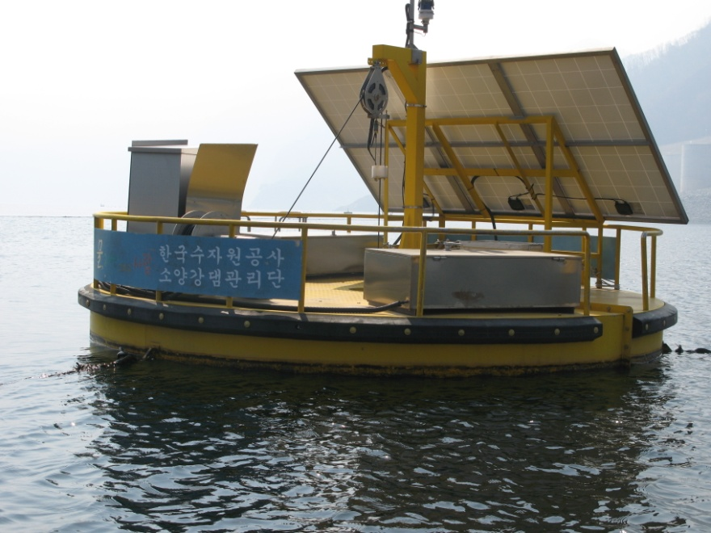
Partner Updates
Korean Lake Ecological Observatory Network:
Developed a robust maintenance-free wireless communication service between water quality sensors in the fields and the KLEON data server,
Used DataTurbine
EDISON (EDucation-research Integration through Simulation On the Net) launched by KISTI
Build on e-Airs program – research and education for CFDs.

Slide 14
PRAGMA’s First 10 Years
Building a Family
Demonstrable Results

Slide 15
Highlights
Mobilized community to assist in response to SARS, and assist AIST with recovery of services
Contributed to launch of local / regional grids
Improved and helped disseminate software
With APGrid PMA promulgated security standards and practices
Supported conduct of science
Helped launch other grass-roots organizations
Created training and leadership programs
Notes:
- Mobilized a global response to the needs of colleagues at the National Center for High-performance Computing (NCHC) in Hsinchu in helping apply technology solutions to the healthcare crisis caused by the SARS virus.
- Contributed to launching local and regional grid efforts of PRAGMA members at Universiti Sains Malaysia (USM, ThaiGrid, NCHC, Jilin University (JLU), Lan Zhou University (LZU, GEOGrid of the National Institute for Advance Industrial Science and Technology (AIST), as well as at Advanced Science and Technology Institute (ASTI), Institute of Information Technology (IOIT), and Universidad de Chile.
- Improved and globally disseminated multiple cluster and grid software from members such as Ninf-G (AIST), Gfarm (AIST and U Tsukuba), Nimrod (Monash U), Duckling (Computer Network Information Center (CNIC)), Rocks (San Diego Supercomputer Center (SDSC)), CSF4 (JLU), e-AIRS (Korea Institute for Science and Technology Information (KISTI)), SCE (Kasetsart U (KU)) Opal (National Biomedical Computation Resource (NBCR)), DataTurbine (University of California San Diego (UCSD)), and SAGE (UCSD).
- Collaborated with APGrid PMA and promulgated security standards and practices among our members and affiliates.
- Engaged application scientists and supported applications on the PRAGMA Grid, examples include: modeling the spread of volcanic ash in Costa Rica (Nunez 2010), understanding the impact of Savannah burns on climate (Lynch 2007), and gaining insights in a variety of computational chemistry applications (Ikegami 2007, Sudholt 2004).
- Provided a testbed platform from pilot work of NCHC’s EcoGrid activities, leading to the Global Lake Ecological Observatory Network (GLEON) organization with more than 300 members, the Coral Reef Environmental Observatory Network (CREON), and other regional activities such as the Korean Lake Ecological Observatory Network (KLEON).
- Created training programs for members and for students, ranging from the SEAIP (Southeast Asia International Joint Research and Training Program in High-Performance Computing Applications and Networking Technology), to programs that support student internships abroad: PRIME, PRIUS, and MURPA.

Slide 16
Software of PRAGMA Members
Software | Institution | PRAGMA Enhancement/Use
Ninf-G | AIST / NAREGI | Many applications
Gfarm | AIST and U Tsukuba | Virtualization Tests Avian Flu Grid
Duckling | CNIC | PRAGMA Workshops
CSF4 | Jilin U | Avian Flu Grid
SCMSWeb | Kasetsart U | GOC
e-AIRS | KISTI | Tested on PRAGMA Grid
Mgrid | Konkuk/Kookmin | Avian Flu Grid
Nimrod Toolkit | Monash | Savannah experiment; Volcanic Ash Distribution PRIME students
MOGAS | NTU - Singapore | Grid Operations Center
DataTurbine | UCSD Calit2 | PRIME, KEON, CREON/Thailand
SAGE | EVL UIC | PRIME
CADD | NBCR | Avian Flu Grid
Opal Toolkit | UCSD NBCR | Avian Flu Grid
INCA | UCSD SDSC | Grid Operations Center
Rocks | UCSD SDSC | Virtualization Tests

Slide 17
“Next year PRAGMA will be 10 years old. In these last ten years we have established deep and broad collaborations and friendships in the Asia Pacific region. We have also developed best practices in interoperations of grids, used the shared infrastructure to make scientific advances and improve software, leveraged the framework to help foster new grid efforts and new organizations, and established mechanisms to enhance the human capital and strengthen our collaborations.”
Yoshio Tanaka

Slide 18
Model for Collaboration
“By actively participating in a large community such as PRAGMA, we can contribute our technology to real-world use in science.” Osaka, NICT
“Above all, PRAGMA brings great value to CCST in terms of broadening international collaboration, engaging applications, publishing scientific papers, and cultivating student.” Jilin University
“There are always PRAGMA members working on interesting problems ready to push the boundaries of what we do.” Monash University
“Learning from the PRAGMA collaboration, NCHC has built grid application platforms which have led to extensive involvement from NARL.” NCHC, NARL
“Several of our own students have benefitted by interacting with [PRIME students]. This has helped us to evolve a very vibrant academic and research group here in our department ….” University of Hyderabad
“PRAGMA led us to become a member of APGrid PMA, which became a significant component in our development of Thailand National e-Science Infrastructure Consortium. … to becom[ing] a part of GEO Grid collaboration .. . and helped with the setting up of a CREON site [at Racha Island]” NECTEC
“PRAGMA has given Konkuk University opportunities for global collaboration with excellent research groups in the world and due to such opportunities, KU has become one of a leading institutes in interdisciplinary education and research in Korea.” Konkuk University
“the exchange of ideas and culture that happened through out these years prepare our researchers to be ready to work in a new globalized world.” Kasetsart University

Slide 19
PRAGMA in 2020
Defining Our Future
Rethinking Our Structures and Processes

Slide 20
Discussing Our Future
Panels
Strategies and future direction of PRAGMA
Networking and PRAGMA
Working Groups
What is your future?
Steering Committee
Talk with Steering Committee!
Synthesize input and strike balance
Goal is to engage all participants – namely YOU!

Slide 21
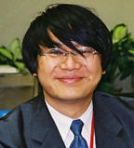
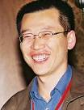
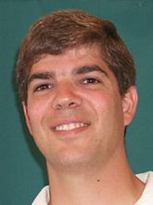
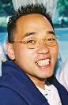
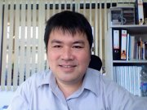
Strategies and Future Direction of PRAGMA
Fang-Pang Lin, NCHC, Telescience
Kai Nan, CNIC, Resources
Phil Papadopoulos, UCSD, Resources
Yoshio Tanaka, AIST, Resources and GEO
Sornthep Vannarat, NECTEC, GEO
“think deeply about the next 5 years
and begin a process of constructing
the ideas, framework, and proposals to
reach into the future”
Be Provocative and Constructive
Notes:
Proposal for Panel at PRAGMA 21
Next year PRAGMA will be 10 years old! In these last ten years we have established deep and broad collaborations and friendships in the Asia Pacific region. We have also developed best practices in interoperations of grids, used the shared infrastructure to make scientific advances and improve software, leveraged the framework to help foster new grid efforts and new organizations, and established mechanisms to enhance the human capital and strengthen our collaborations.
During these ten years, technologies have changed, funding to support collaborations has mostly been by and for individual members, PRAGMA has grown in number of members yet not all have funding or mandates to sustain the collaborations.
This is an ideal time to look forward on several fronts, to ask what we see as future trends, and where PRAGMA members collectively can make a unique contribution. At PRAGMA 17 in Hanoi, Vietnam (October 2009) there was a panel meeting on the future of the cloud and what PRAGMA should do. That panel discussion, with work at and between subsequent workshops, led to a very active set of activities highlighted at PRAGMA 20 and PRAGMA 21.
We propose to hold a panel discussion on the future of PRAGMA, looking at trends in the following areas:
Technology: What are the future trends in areas of cloud (compute and data), sensing (remote and land based), visualization, and networking? Where does PRAGMA have an advantage? Are there other technologies? Are there activities we should stop doing?
Scientific Applications and Infrastructure co-development: PRAGMA currently have working groups in GEO, Bio, Telescience and Infrastructure. What are the major contributions that PRAGMA could make in these areas? Are there opportunities/interest in new activities? How can these groups accomplish more by working more closely together?
Human Capital: What are opportunities for developing human capital in PRAGMA and at the same time further out technology and application goals? Currently PRAGMA does not have an education working group, but has had several activities among PRAGMA members such as PRIME, PRIUS, and MURPA. Furthermore there are activities such as SEAIP that has been a feeder for PRAGMA members and a means of disseminating information about PRAGMA.
Collaborative Funding: What are opportunities to move from individually applied for funds to collaboratively seeking funding to influencing funding agency priorities?
Membership: How do we sustain activity of members or allow natural ebb and flow of members? Also, thinking in terms of fulfilling some of the visions, are there other institutions or communities (e.g., computer science, biodiversity) we should recruit into PRAGMA?
We propose to have a five member panel, each member to address at most two of these issues, to paint a vision for what the future could hold for PRAGMA and how PRAGMA could uniquely contribute to that future. Following brief statements by the panelists, there will be a moderated question and answer session of all PRAGMA 21 participants.
The goals of this panel and question and answer session to have PRAGMA membership think deeply about the next 5 years and begin a process of constructing the ideas, framework, and proposals to reach into the futur
Address and poke holes in the proposed framework!
Discuss current working groups and their structure
- Are the areas still relevant
- Do we need
How to we engage new members?
How do we stay “innovative”
REMINDER: Commenting on structure, processes, proposals are comments on ideas, not on PEOPLE.

Slide 22
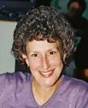
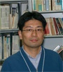
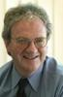
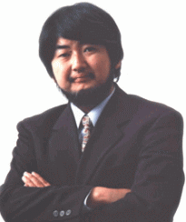
Networking and PRAGMA
Maxine Brown (UIC)
Tomohiro Kudoh (AIST)
George McLaughlin (IU/TransPAC)
Shinji Shimojo (Osaka U)
What is the role of networking
in our future?
“how PRAGMA can collaborate
with network communities and
how PRAGMA will introduce the latest
network technologies”
Notes:
http://www.aist.go.jp/aist_j/aistinfo/aist_today/vol06_12/p18.html

Slide 23
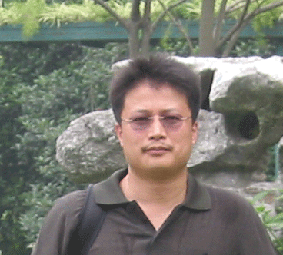
Challenge to the Working Groups
Resources
GEO
Telescience
Biosciences
What are key challenges for the next five years that PRAGMA can uniquely address?
Who, What?
Does the current working group structure still make sense?
Overall area, current projects

Slide 24
Framework for Discussion of Future
Developing, experimenting with, and exploiting new technologies
Addressing application areas important to the societal concerns of the region
Continuing to grow collaborations and people
Does this framework capture the critical
components for our success?
What are PRAGMA’s unique contributions?
Notes:
1. Future PRAGMA activities will build on our past successes and will build on three key thematic areas:
- Experimenting with and exploiting new technologies, via three activities:
- Building the computational and data cloud, to make the use of applications easier;
- Exploiting the ubiquity of sensors throughout our natural and man-made environments and the explosion of sensor and instrument data, to inform our models and understanding of the world; and
- Utilizing visualization and collaboration technologies to understand the data and models, collaborating regardless of whether researchers are together in one location or geographically dispersed.
2. Addressing application areas important to the societal concerns of the region. The four challenge areas are:
- Disaster Mitigation: Beyond disaster recovery of key services and systems is understanding the impact from earthquakes and flooding on structures and transportation, as well as modeling responses using sensor data input.
- Environmental Observing and Modeling: We will continue to grow strong ties with lake and coral reef ecologists, and will expand into the areas of biodiversity and understanding chemical or molecular distribution based on soil chemistry.
- Health: This is a concern, not only because of the SARS and Avian flu outbreaks, but also because many of the world’s neglected diseases (a group of tropical infections) that originate in the region. We have already taken steps to create tools that will enable better approaches to identifying possible candidate targets to active sites of the proteins involved, and now plan to integrate various tools from across PRAGMA.
- Culture Interaction: Finally, as our globe becomes increasingly connected, sharing local and regional cultural heritage allows for greater understanding of a region and the variety of people in it.
3. Continuing to grow collaborations and people: The two approaches we pursue are:
- To make progress in these applications areas requires building a broader group of expertise in areas ranging from the application sciences to computer and information science and engineering. The technologies of both the cloud and sensors have many unanswered questions, and the driving areas require multidisciplinary approaches to make progress.
- Furthermore, we will engage students at various levels of their careers to demonstrate the excitement of these areas and the value of international collaboration, thus growing our community for the future.

Slide 25
Current and Future Challenges
People
Identify and engage (persistently) new researchers
Engage application scientists
Involve students
Products
Create products for each other, for the broader community
Innovation
Promote continual innovation
Obtain joint and coordinated funding
“The problems we face are global, but our funding is local.”
Can we work together with the funding agencies to address this challenge?
Notes:
Challenges:
Joint and Coordinated Funding: One discussion we will want to have, collectively, is how to better coordinate funding opportunities among the partners. One specific discussion will be between Yoshio Tanaka (AIST Japan), Weicheng Huang (NCHC Taiwan), Phil Papadopoulos (UCSD USA)
Engagement of new researchers
Identifying people with overlapping interests and time
Integrating them into our activities
For NSF: for US long-term participants – engage them in a manner / at a level that allows them to participate between meetings – while not breaking the bank
Engage applications
Identify a science boundary we will move forward
Create products
Show software
Consider PRAGMA VM images
Students
Yoshio to Bill 19 September 2011
We are really glad to know that you can come to Sapporo!! Great!!
I'll inform Weicheng, etc. about your attendance and discuss how we should proceed.
Next year is PRAGMA's 10 years anniversary. In the past 10 years, we could establish deep and wide friendship/partnership in Asia Pacific region. We could also have valuable experiences and research results which could be achieved on real distributed and multi-institutional infrastructure.
On the other hand, we have to consider the next 10 years from various aspects, for example...
- PRAGMA grows and currently there are 35 member institutions. It's
good to broden the community, but the contribution by each
institution may not be clear. Should PRAGMA grow more? or should we
keep the size of the community?
- There are three application WGs, GEO Sciences, Bio Sciences, and
Tele Science. Are these appropriate and enough?
# Be noted that Education is also active in PRAGMA though it is not
# formed as a WG.
- PRAGMA is a NSF project and the budget is for UCSD/SDSC. The other
institutions have their own budget. Of course, PRAGMA helped us to
get funding by writing support letters, etc., but we are always
looking for a way to create more funding among partners for
sustainable contribution.
These issues are from political/strategic point of view rather than technical point of view.

Slide 26
Rest of the Program
Demonstrations – what is possible
Posters – time for discussions
Key note talks – stimulate thinking
Particular thanks to speakers and colleagues
Working Group discussions – what is practical
Steering Committee meeting – synthesize what has happened and where we are going

Slide 27
Thanks to the Organizers and Committee Members
Program Committee
Yusuke Tanimura (AIST), Kohei Ichikawa (Osaka), Chao Jin (Monash) and Seok Jong Yu (KISTI)
Chih-Wen Chang (NCHC), Supakit Prueksaaroon (NECTEC)
Kevin Dong (CNIC), Rommie Amaro (UCI/UCSD)
Secretariat
Yuko Oshimia (AIST)

Slide 28
Acknowledgements
Organizers
Sponsors
AIST
Osaka University
Tokyo Institute of Technology
University of Tsukuba
Ministry of Educaion, Sports, Culture, Science and Technology (MEXT)
DataDirect Network Inc
Appro International Inc
Argo Graphics
BioGrid Center Kansai
Cray Japan
KDDI R&D Labs Ince
NEC Corporation
SGI Japan
Beyond Computing Co.Ltd
Thank You!

